Slide 1
Lecture 2 – Building REST API

Slide 2
Quick Review: RESTful Webservices
REST = Representational State Transfer
Based on Roy Fielding’s 2000 PhD thesis (Ch. 5)
An architectural style for building loosely coupled systems
The Web itself is an instance of that style
Web Services can be built on top of it

Slide 3
The Resource-Oriented Architecture
A set of design principles for building RESTful Web Services
Addressability
exposes a URI for every piece of information it might serve
Uniform interface
small set of methods applied to a large set of resources
HTTP GET, POST, PUT, DELETE
Connectedness
Served documents contain not just data, but also links to other resources
Statelessness
every HTTP request executes in complete isolation
server never relies on information from a previous request

Slide 4
Tools and Frameworks
Ruby on Rails
a framework for building RESTful Web applications
Django
framework for building RESTful Web applications in Python
Spring
Framework for a lot of things, one of which can be used to build RESTful Web applications in Java

Slide 5
Open Your Laptop and start IntelliJ (Ultimate Edition)
Will create a REST API

Slide 6
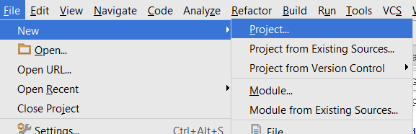
#1 Create New Project

Slide 7
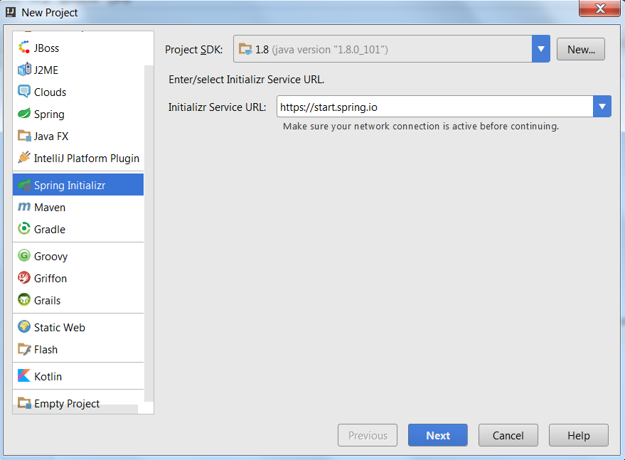
#2 Select Spring Initializr

Slide 8
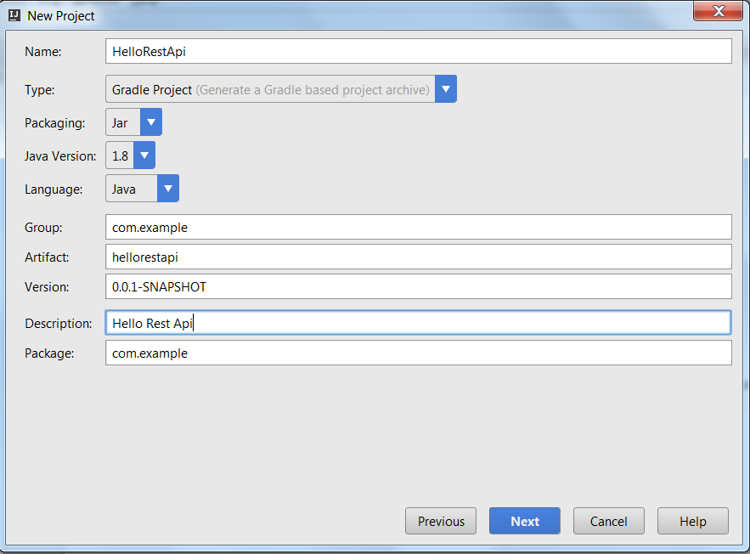
#3 Enter name and select “Gradle Project”

Slide 9
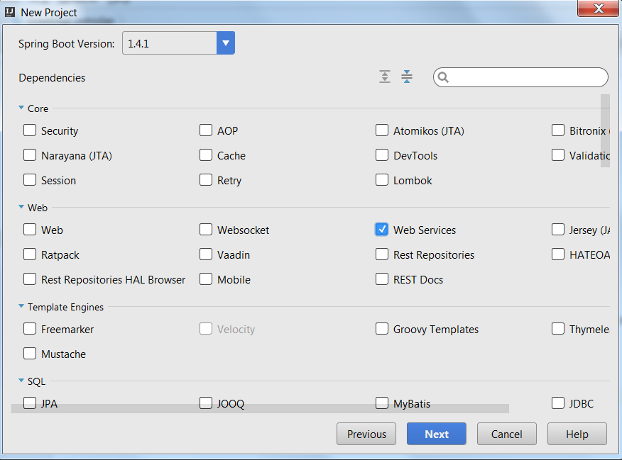
#4 Select Web Services

Slide 10
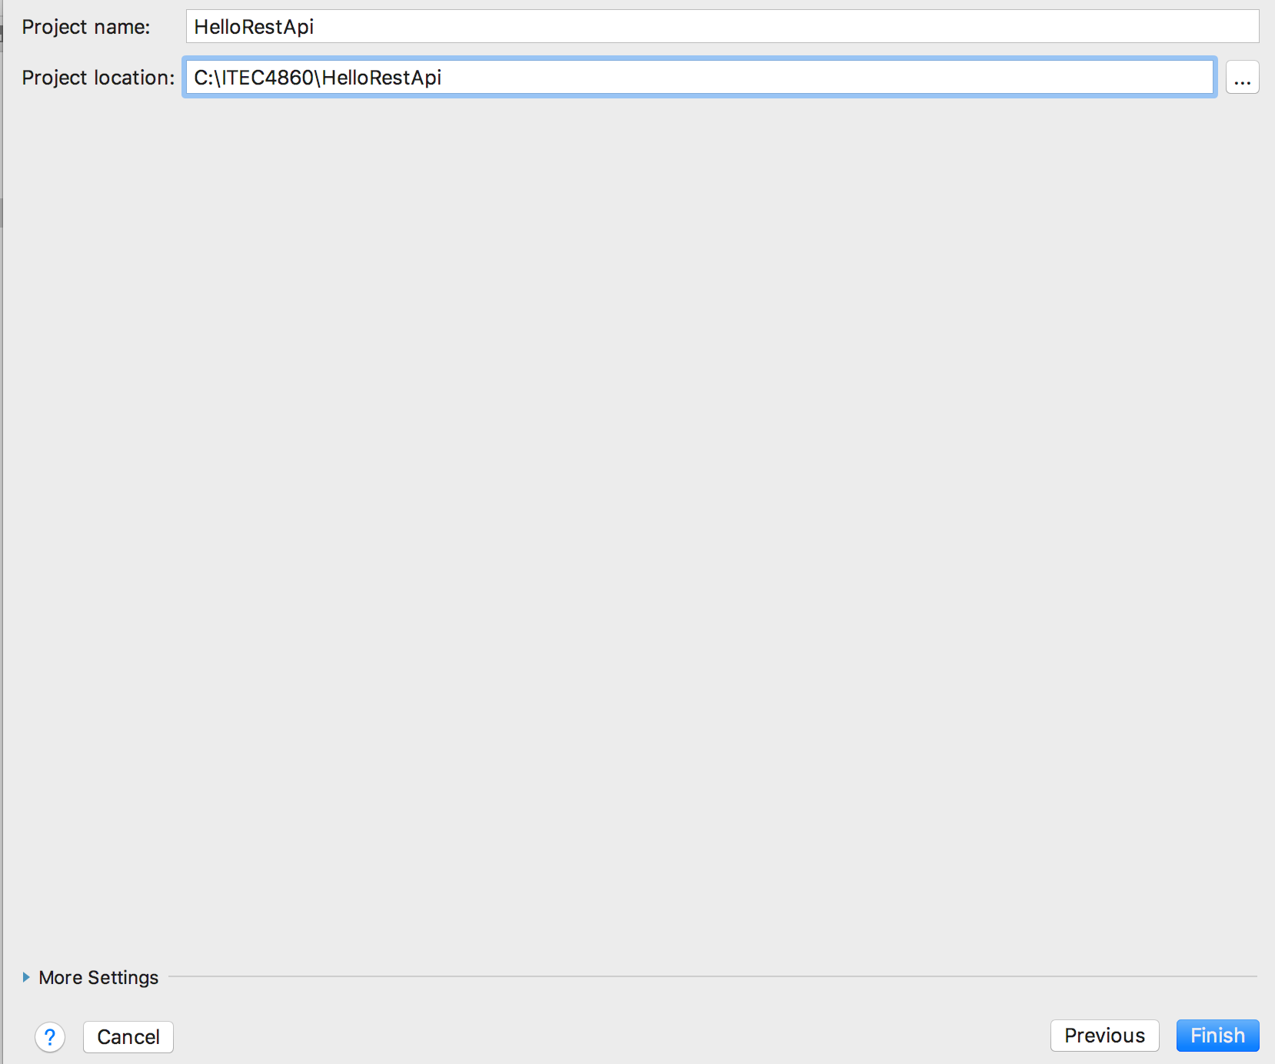
#5 Specify Project Location

Slide 11
#6 Now you have a Spring Boot Project
Spring Boot provides a way to build Java applications quickly with an embedded server
Tomcat
Java HTTP web server environment to run Java code
Will build REST API with Spring Boot

Slide 12
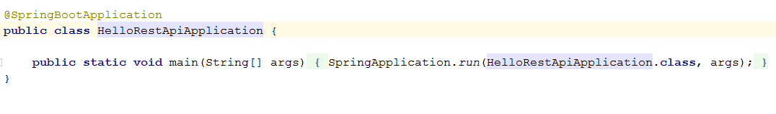
#7 Look at the file HelloRestApiApplication.java
This is generated file
Entry point
Starts a Spring context and Tomcat

Slide 13
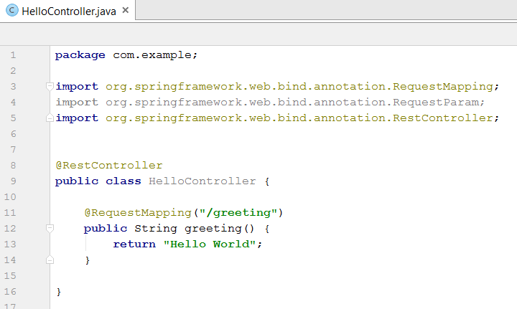
#8 Create a REST Controller to handle requests

Slide 14
What’s going on?
The annotation @RestController tells Spring to make it a REST-endpoint
First this class is a controller that should be managed by Spring and will be picked up by component scanning.
Second, the return value will become the body of our response.
The annotation @RequestMapping("/greeting") tells us that this controller will handle all requests with /greeting in our application.

Slide 15
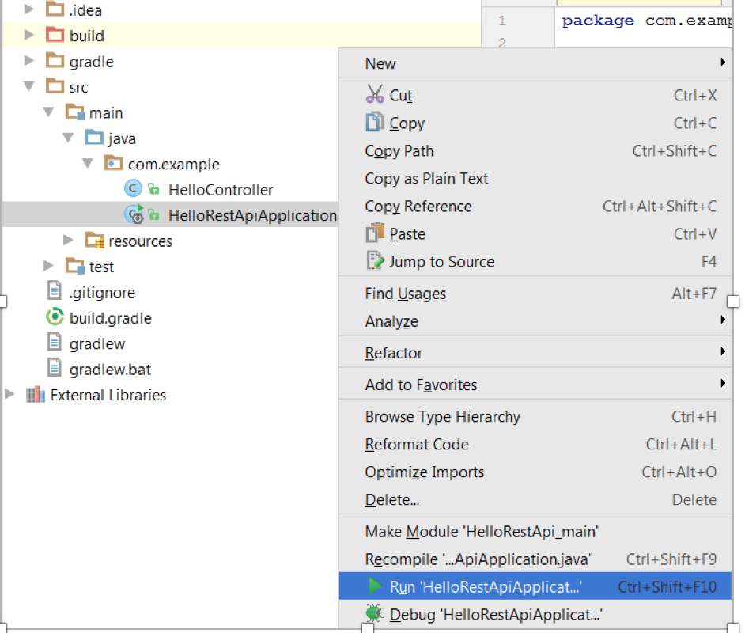
#9 Run it!

Slide 16
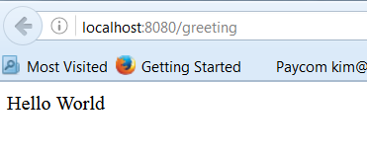
#10 Open a browser and send a request to greeting and see the response from the controller and request mapping we just created

Slide 17
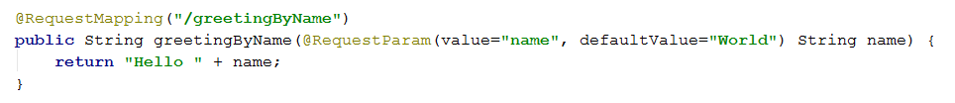
#11 Let’s add a new RequestMapping
Want to handle all requests with /greetingByName in our application.
BUT want to accept a parameter from the user
Use @RequestParam

Slide 18
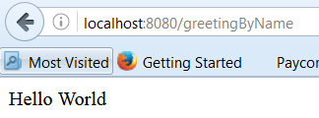
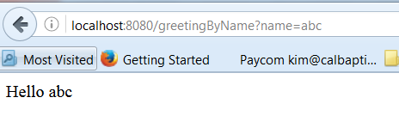
#12 How to make your request to the new API?
How to pass a parameter in my request?

Slide 19
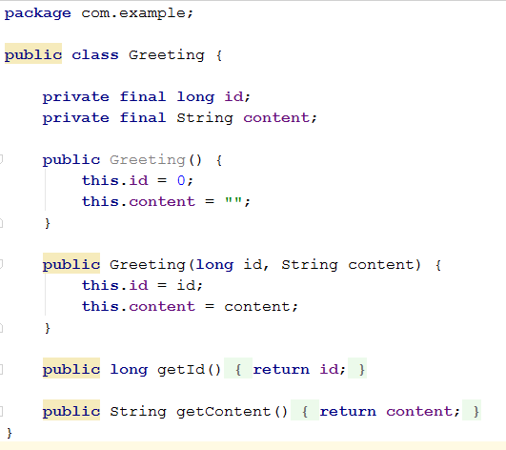
#13 Create a new class called Greeting

Slide 20
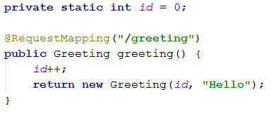
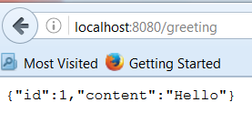
#14 When greeting request is received, let’s return an instance of Greeting
What is this output format?

Slide 21
#15 Why is the Output in JSON format?
Spring uses the Jackson JSON library to automatically assemble instances of type Greeting into JSON.
When we return a Greeting object, the object data is written directly to the HTTP response as JSON.
Jackson JSON library maps the keys in the JSON to the names of the instance members

Slide 22
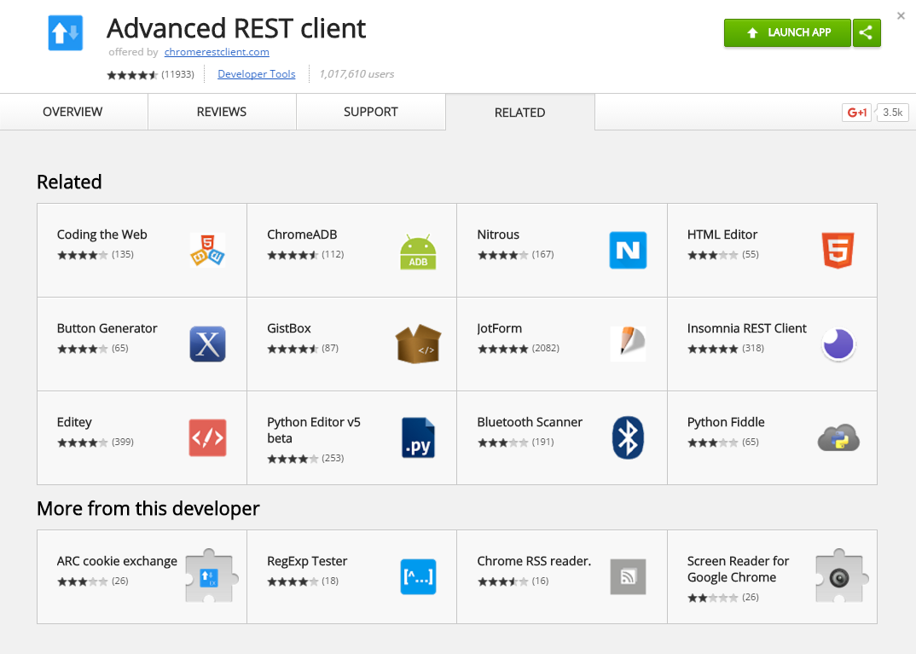
Sending POST Request Through Browser?
Use Chrome
Install this Extension

Slide 23
In-Class Exercise
Show me your work before you leave to get credit

Slide 24
Next Class REST API Part 2: Bring your laptop again! With Advanced REST Client installed in Chrome! Make sure what we covered today is working on your IntelliJ project HW will be assigned on this very topic

